Slide 1

PokerJunkie
Group 13: Urja Soni, Chance Potter, Kena Patel, Jolekha Begum

Slide 2
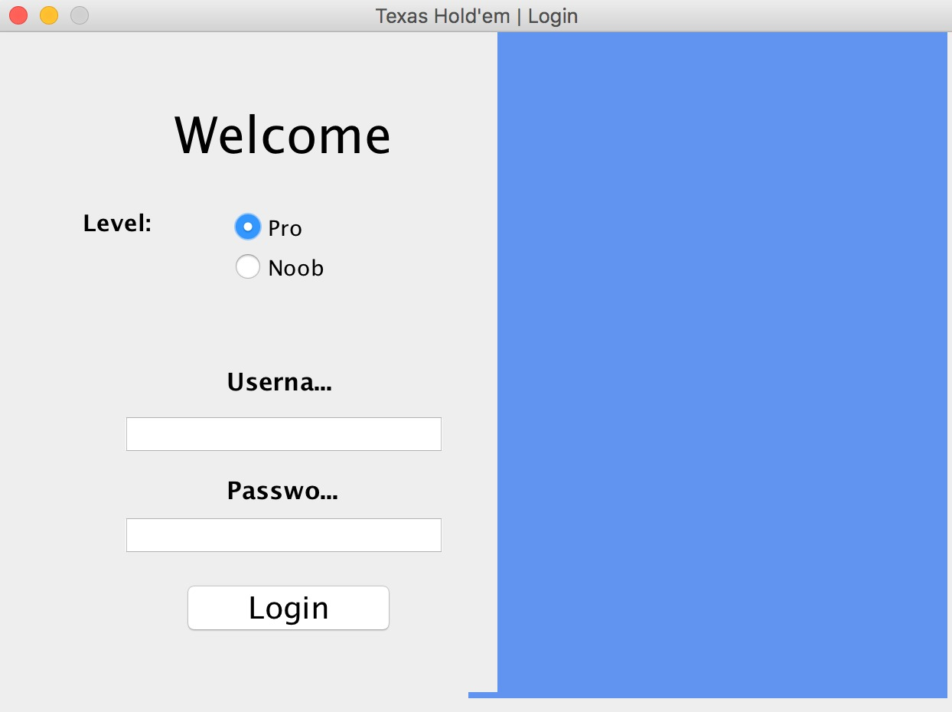
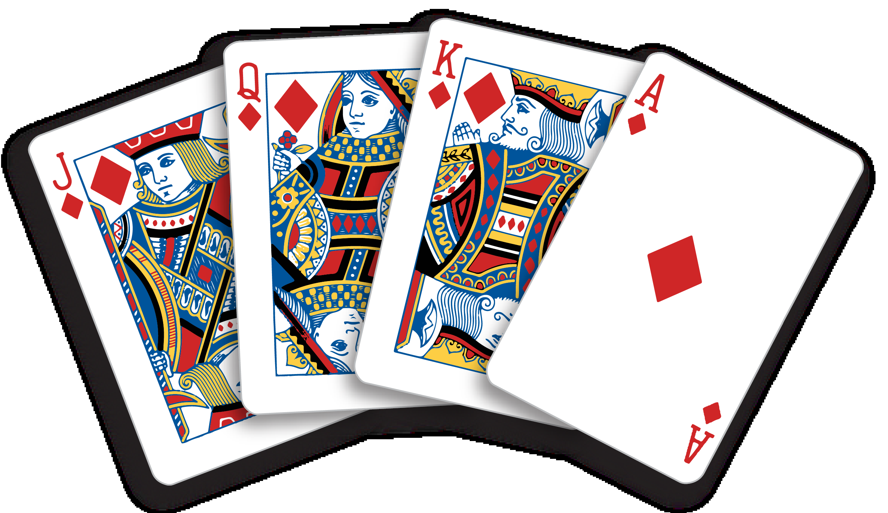
Overview
Allows players to play poker game
User Chooses their experience level
Two levels for players: Experienced & Newbies
Logs into the game.
Keep track of the game score & how many games user has won.

Slide 3
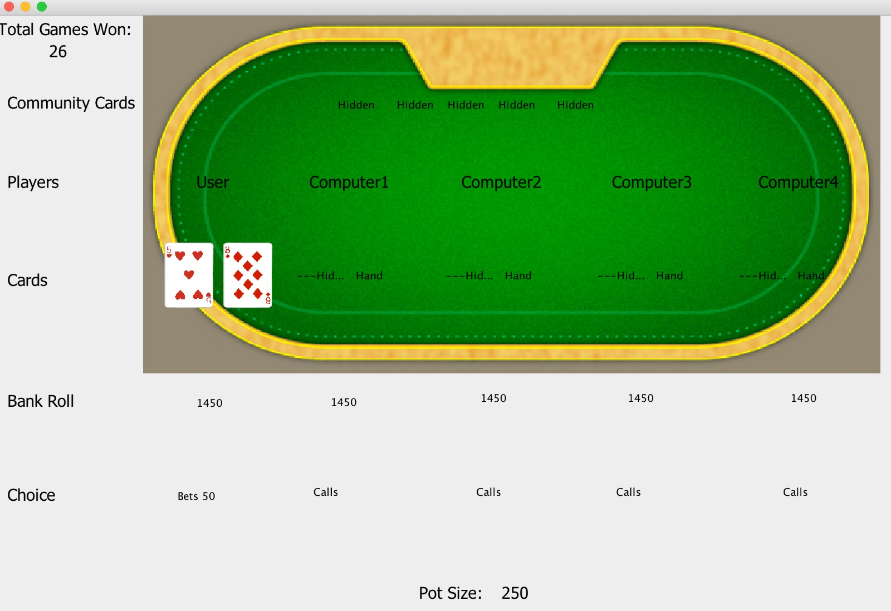
The Poker Table
AI
Keep track of the scores
Everyone starts with $1450
Shows Moves of players

Slide 4
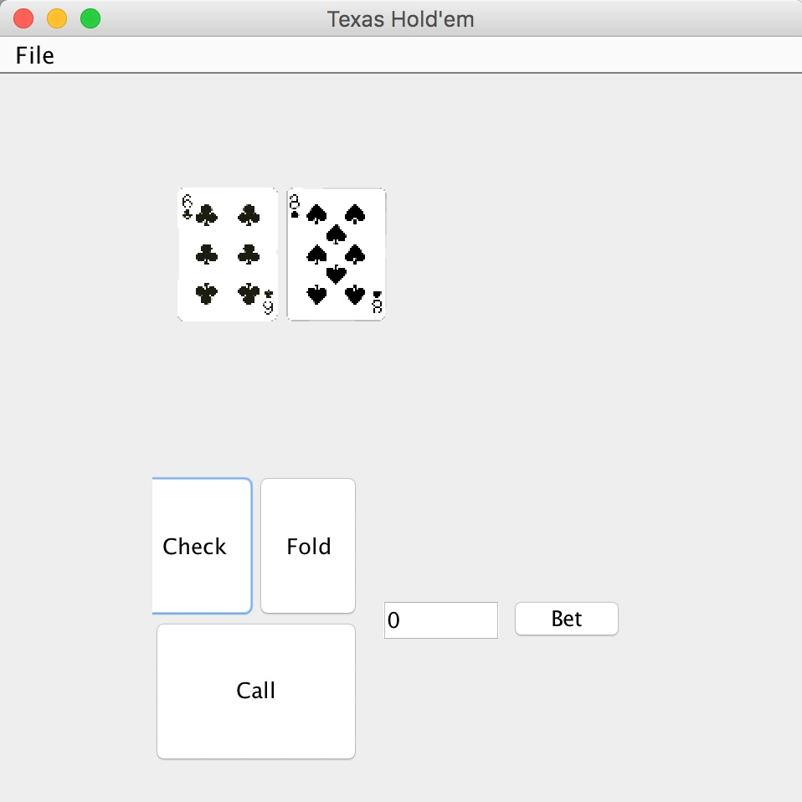
GUI to make moves
4 options to make moves
Check
Fold
Call
Bet
Write how much money they want to bet

Slide 5
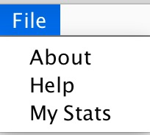
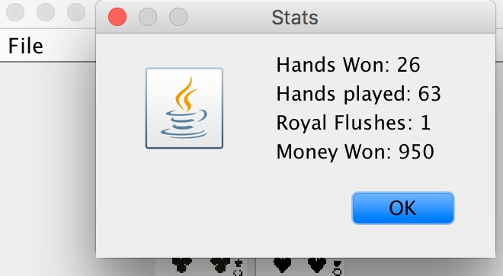
File Option
Provides more details
About:
Shows information about the game
Help:
How to play. What each move means.
The rank of each hand and what they are
My stats:
Player’s score information

Slide 6
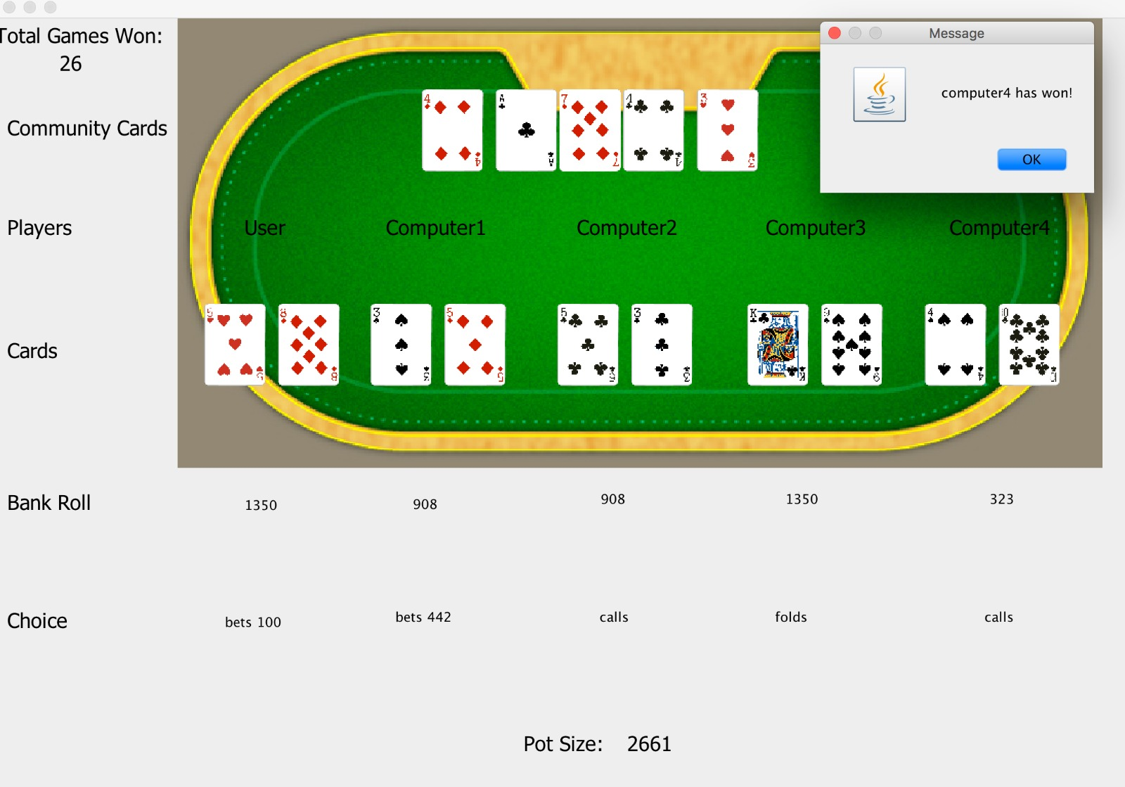
Detect Win
Show who won the game
Progressively shows cards
Shows other player cards at the end of the round

Slide 7
End of the Coding Project

Slide 8
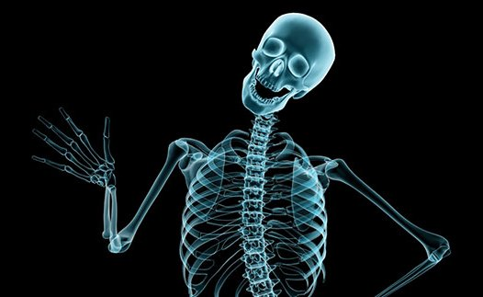
X-Ray Simulation Software

Slide 9
Summary
Our plan is to give medical students a place where they will have virtual reality aspect to learn and practice X-Rays
Students will be able to position virtual patients and take virtual X-rays
They will be first trained and later they will be tested
Students will be required to pass certain number of X-ray tests before they actually go perform their duty in the real world

Slide 10
Requirements
Functional:
Virtual environment for all body parts
The virtual objects should look like real ones and should have realistic measurements
Options for user to practice or perform actual test
System should have ability to store user data to the server
Performance:
The response for moving the virtual patient should be instant.
Getting user data from server should only take few seconds.
Accuracy:
Scan tests should be accurate compared to real world scans.
Usability:
The new user should be provided with a tutorial on how to navigate through the system.
The user should have ability to choose a region/language accordingly.

Slide 11
Requirements (cont)
Reliability:
The user’s progress should be saved automatically when the system crashes.
The program should not fail to load or keep the user waiting during their exercise.
The application must be available 24 hours a day, unless there is maintenance.
Supportability:
Two maintenance teams assisting via:
Phone
Email
The features should be updated over the time.
Any reported bugs should also be addressed by the next update time.

Slide 12
Test Plans
Things to be tested:
Correctly getting the scans
Correctly evaluating student’s results
Keeping database up-to-date with correct scores
VR giving real life experience
Store user’s previous test information to access later

Slide 13
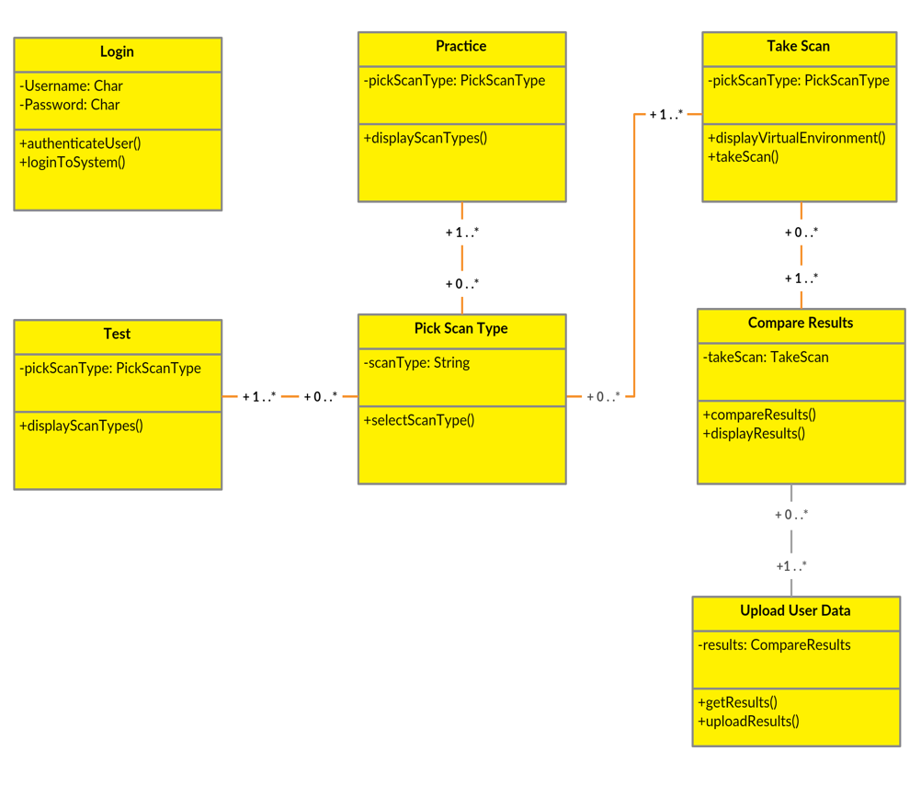
Design Goals
User Login (To keep track of user info)
Main portal
Pick a topic/scan to practice
Complete the module
Take scan test
Autograder (evaluating the scans)
Update data on database

Slide 14
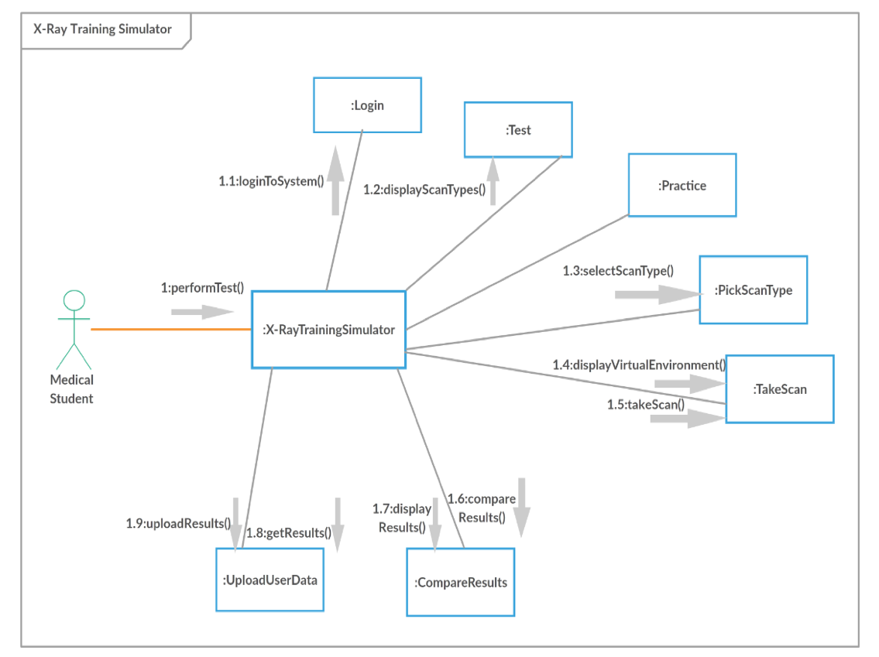
Design Goals (Cont)
Communication Diagram:
Classes that will be used

